Slide 1
Implementation and Comparison of Three Algorithms for Voronoi Diagram Generation
Osman Serhat Yılmaz - 21902903
Kaan Kurçer - 21902348

Slide 2
Randomized Incremental Algorithm
Has a time complexity of O(nlogn)
The points are added incrementally
After each point addition, the circumcircles of the delaunay faces are checked
Then, triangulation gets adjusted

Slide 3
Randomized Incremental Algorithm
A triangle which contains all of the points is generated.
A random point which hasn’t been selected already is chosen.
A line is drawn to each of the vertices of the triangle which contains the point.
For each edge of the triangle, a circumcircle which contains the points that make up that edge and the chosen point is drawn.
If the circumcircle contains another point which has been introduced into the algorithm, draw a line from the three points to that point. Then do the same check for each of the newly generated edges.
Do steps 2 - 4 until all points are chosen.
Remove the initial triangle and all the edges that are connected to its vertices.

Slide 4
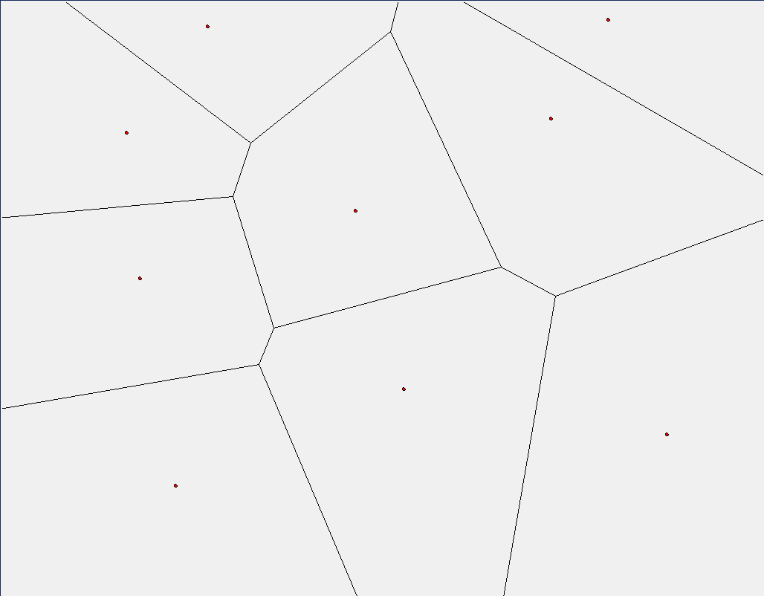
Randomized Incremental Algorithm

Slide 5
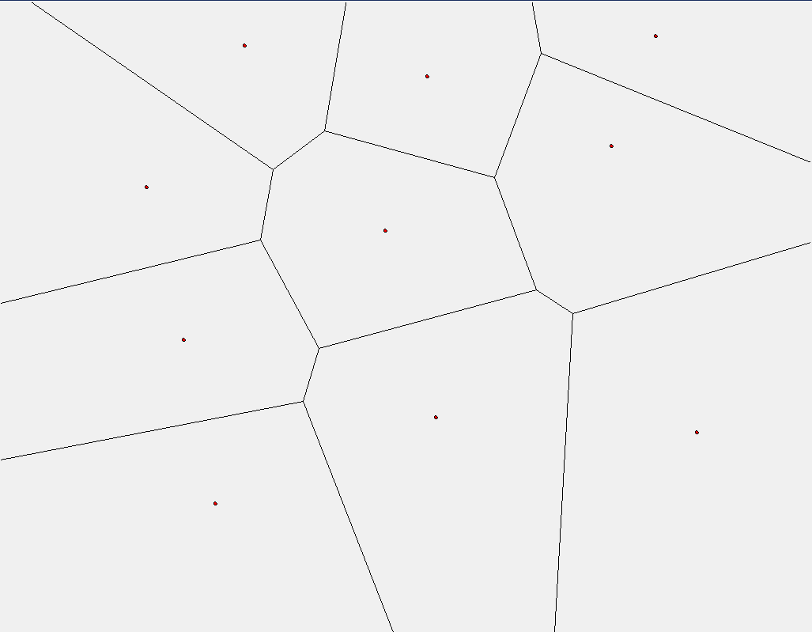
Randomized Incremental Algorithm

Slide 6
The Flipping Algorithm
Initially, the points on the plane are used to create an arbitrary triangulation
The arbitrary triangulation is made using a similar approach to random incremental algorithm, but in the initial creation there are no checks, checks are made after all triangles are created.
After this step, the triangulation is flipped so that a Delaunay Triangulation is obtained.
Then, Delaunay Triangulation is used in the computation of the Voronoi Diagram.

Slide 7
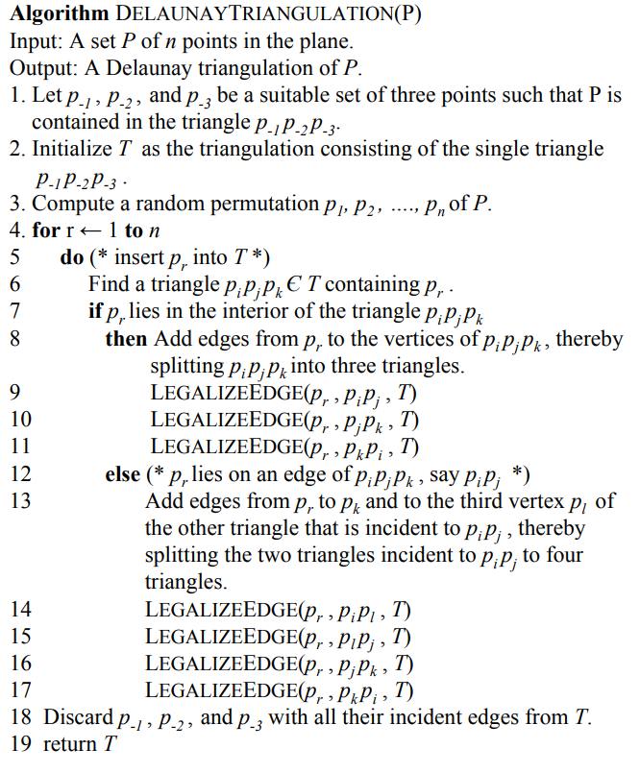
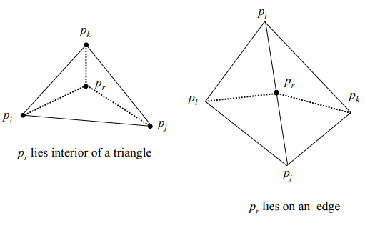
The Flipping Algorithm

Slide 8
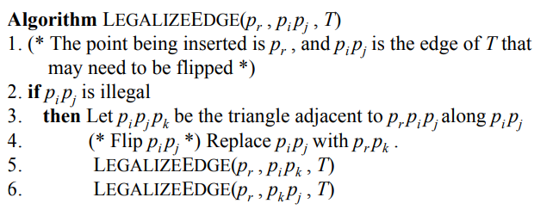
The Flipping Algorithm

Slide 9
Fortune’s Algorithm
Fortune's Algorithm is a sweep line algorithm
It processes the input data linearly using a line that sweeps across the input points.
The events can be classified into two types: vertex events, point events.

Slide 10
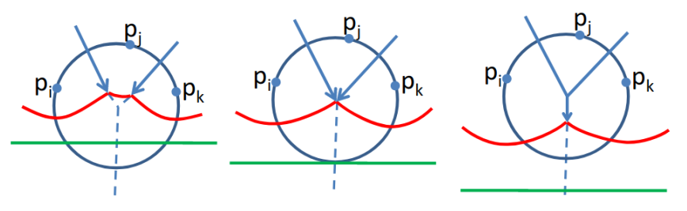
Fortune’s Algorithm: Vertex Events
Vertex events occur when the sweep line reaches the bottom of a parabolic arc in the beach line.
These events represent the creation of a new Voronoi vertex, which is the intersection point of three Voronoi edges.

Slide 11
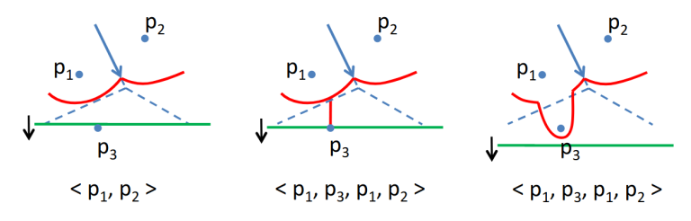
Fortune’s Algorithm: Point Events
Point events occur when the sweep line encounters a new input point, and these points are used to define the Voronoi cells.
A new parabolic arc is created in the beach line, which is a data structure that represents the current state of the diagram as the sweep line moves across the input points

Slide 12
The Algorithms & Tools
The following algorithms were implemented successfully and are compared with each other in terms of performance:
Randomized Incremental Algorithm
The Flipping Algorithm
The following tools/libraries have been used during the implementation:
Python
NumPy
Matplotlib for plotting
Tkinter for the interface

Slide 13
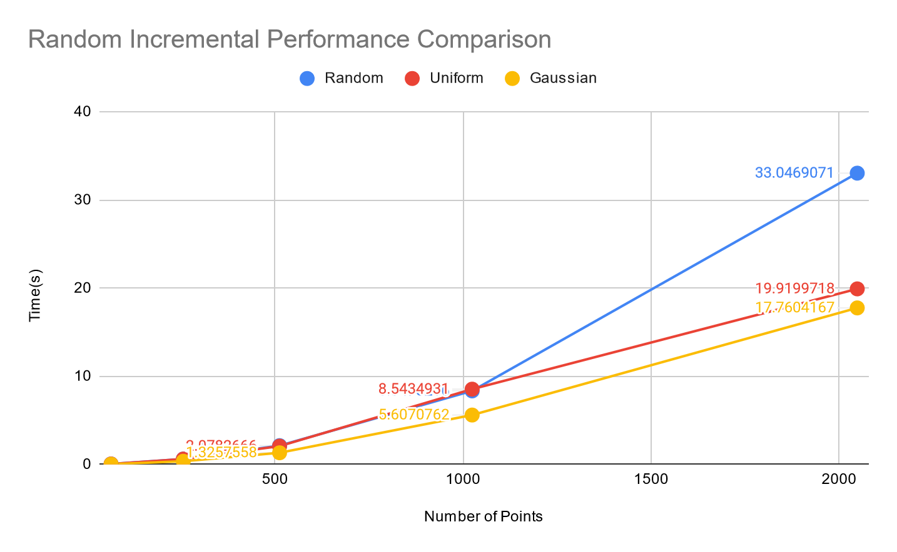
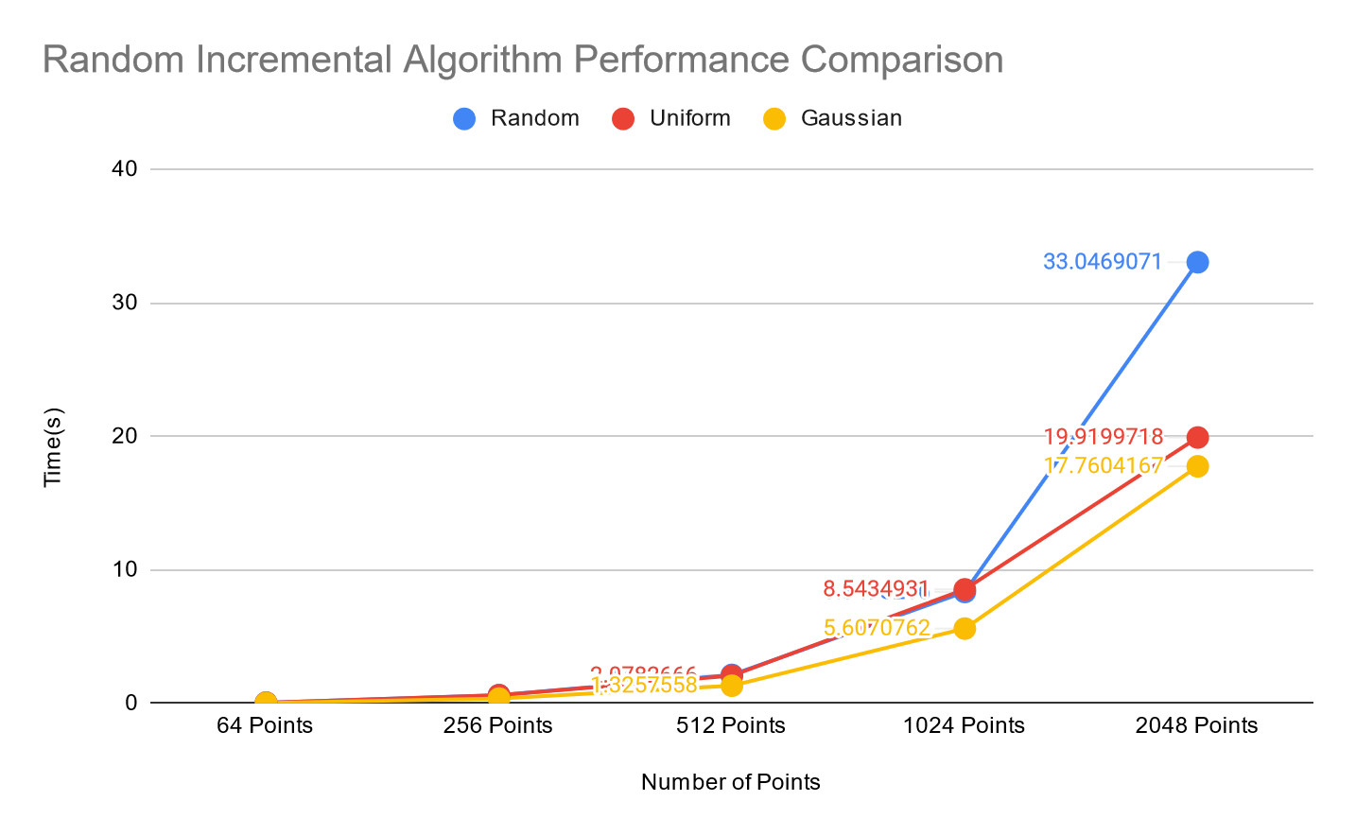
Algorithm Performance
Random Incremental | Random | Uniform | Gaussian
64 | 0.0547292 | 0.0512497 | 0.0303546
256 | 0.6181948 | 0.6153923 | 0.3640604
512 | 2.1364411 | 2.0782666 | 1.3257558
1024 | 8.3478266 | 8.5434931 | 5.6070762
2048 | 33.0469071 | 19.9199718 | 17.7604167

Slide 14
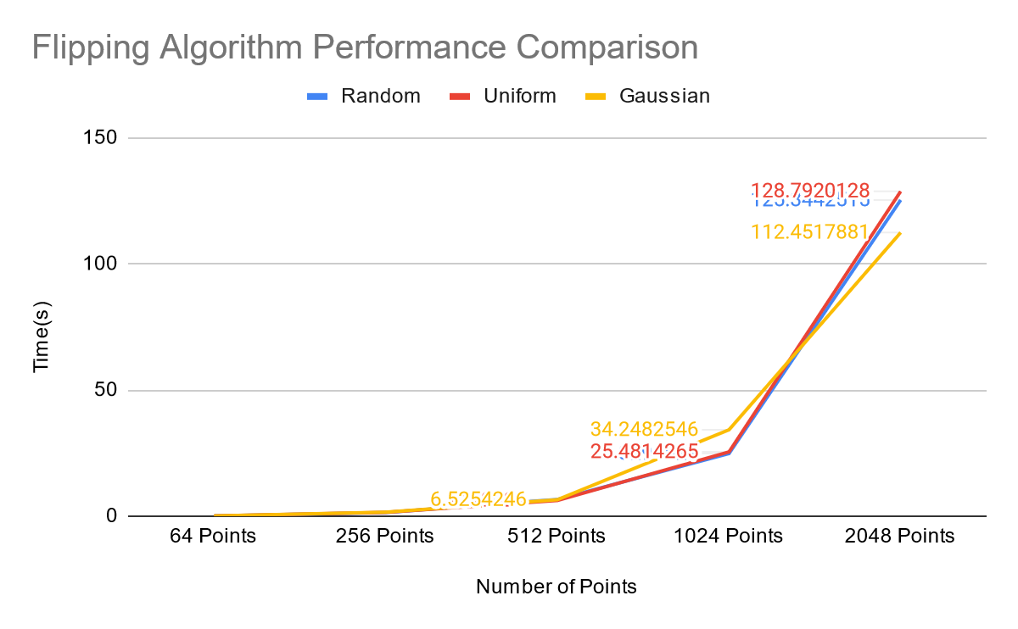
Algorithm Performance
Random Incremental | Random | Uniform | Gaussian
64 | 0.0547292 | 0.0512497 | 0.0303546
256 | 0.6181948 | 0.6153923 | 0.3640604
512 | 2.1364411 | 2.0782666 | 1.3257558
1024 | 8.3478266 | 8.5434931 | 5.6070762
2048 | 33.0469071 | 19.9199718 | 17.7604167
Flipping | Random | Uniform | Gaussian
64 Points | 0.0865438 | 0.0977953 | 0.0957385
256 Points | 1.4456029 | 1.505821 | 1.5920878
512 Points | 6.6161054 | 6.2149324 | 6.5254246
1024 Points | 24.8294821 | 25.4814265 | 34.2482546
2048 Points | 125.3442515 | 128.7920128 | 112.4517881

Slide 15
Conclusion
From our observations, we have come to the conclusion that:
In general, Random Incremental Algorithm performs better than Flipping Algorithm regardless of the input size or the distribution of points.
Comparing the point distributions in Random Incremental Algorithm, it was found that Gaussian Distribution is the most efficient, whereas Random Distribution is the least efficient.
Comparing the point distributions in The Flipping Algorithm, it was found that Random Distribution is the most efficient, whereas Gaussian Distribution is the least efficient.

